Slide 1
Year Plainning for Church Growth
Tiago Pereira

Slide 2
Análise de projeto slide 2
Discipleship Cycle
6
1
Disciple
Catch Attention
PROCESS
5
2
Commitment
Deeper Interest
4
3
Bible Study
Involvement

Slide 3
Análise de projeto slide 3
Year Planning Principles
CLARITY
MOVEMENT
ALIGNMENT
FOCUS
It’s the ability to be easily communicated and understood by people. Clarity involves certainty and eliminates confusion.
It’s the sequence of steps in the process that moves people towards larger areas of commitment. It is the movement that takes people to the next stage.
It’s the organization of all ministries and staff around the same process. The entire church moving in the same direction. All departments submit to and relate to the same overall process.
It’s a commitment to let go of everything outside of the process to reach the goal. Focus, most of the time, means saying no to what is not part of our goal.

Slide 4
Análise de projeto slide 8
Análise de projeto
POSITIVE
NEGATIVE
STRENGTHS
WEAKNESSES
INTERNAL
EXTERNAL
OPPORTUNITIES
THREATS

Slide 5
Análise de projeto slide 10
Year Planning Principles

Slide 6
2 waves

Slide 7
Análise de projeto slide 3
Year Planning for Growth
1st WAVE
2nd WAVE
It starts in the second week of January with 10 days of prayer and ends with a baptism at the end of April.
It starts in the second week of August and ends with a baptism in the November week of prayer.

Slide 8
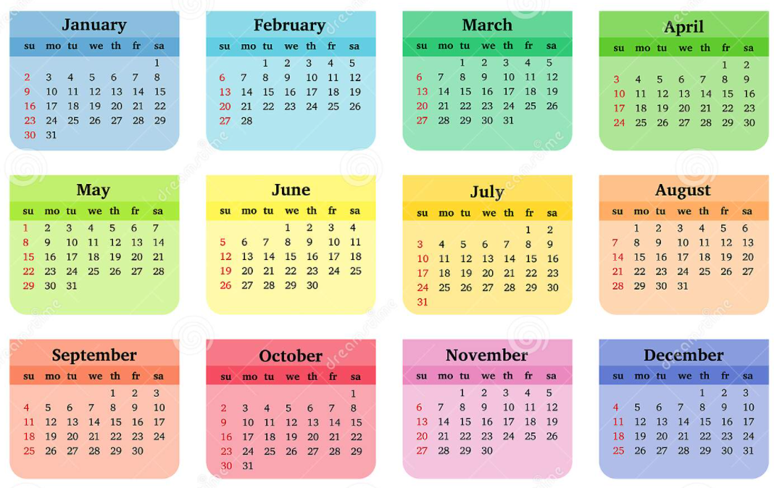
Análise de projeto slide 10
Year Planning for Growth

Slide 9
The best year plaining is the one that involve the whole Church

